Slide 1
Unit-III
Interaction and Behavior modeling
1.Activity Diagram

Slide 2
Activity Diagrams
Use cases tell what the system will do
Activity diagrams will tell how your system will accomplish it’s goal.
High level actions chained together to represent process.
Use symbols similar to Flow chart
But flowcharts notation does not support parallel behavior

Slide 3
Activity Diagrams
Context of the activity diagram – classifier whose behavior it is describing.
Activity can access attributes and operations of classifier, any objects related to it.
Activities are intended to be typically reused across application. Actions are typically specific.

Slide 4
Activity Diagrams
Can be helpful in visualizing the use case steps
Better view compared to table view of use case description
Indicate flow of control and objects as well
Useful as visual representation of Use case

Slide 5
Activity Diagram Elements
Initial node
Activity final node
Action
Flow/edge
Fork
Join
Decision
Merge
Synch

Slide 6
Activity Diagrams
Activity
Is a process being modeled [washing a car]
Actions
Step in the overall activity [ Rinse, Dry etc.]
Can be calculation [add tax] or step [verify]
Can contain pre/post conditions and pseudo code
Notes can be used for local pre/ post conditions for actions
Distinction between action and activity
Action state refers to it as action
Use term activity only refer to the whole task being modeled by the activity diagram

Slide 7
Basic Elements—Action
The rounded rectangle represents an action that occurs.
Action Node/Activity node
E.g., Customer calls ticket office :
Customer Calls Ticket Office

Slide 8
Initial state
The filled circle is the staring point of the diagrams.
The initial state shows the starting point for the action sequence within an activity diagram.
Initial state can indicate only ONE action

Slide 9
Activity Edge
-show flow through activity
-can be control flow or object flow
Send payment
Accept payment

Slide 10
Control Flow
-control passing from one activity to another
Send payment
Accept payment

Slide 11
Object/data flow
-
Generate bill
Make
payment
Bill
object

Slide 12
Activity Diagrams
Tokens used: information moving along edge
input and output of an action
The flow of control
An Object
Nodes
Action nodes
Control nodes
Object nodes

Slide 13
Final node
The filled circle with a border is the ending point.
An activity diagram can have zero or more activity final nodes
First Action To DO

Slide 14
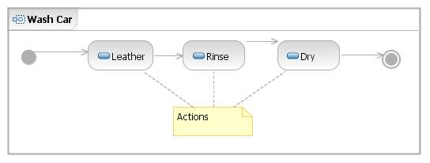
Activity Diagrams
Activity name
Activity
Frame

Slide 15
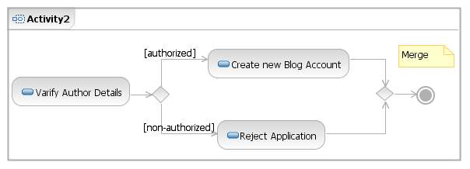
Activity Diagrams (Control Node)
To represent Decision, Concurrency , Synchronization
Decision
Different sequence of actions depending on the conditions
A diamond with one flow entering and several leaving.
Merge : Incoming edges
Guard
Condition
Outgoing edge
Incoming edge
Decision
Merge

Slide 16
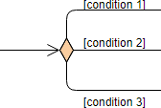
Decision Node
A decision node accepts tokens on an incoming edge and presents them to multiple outgoing edges.
Which of the edges is actually traversed depends on the evaluation of the guards on the outgoing edges.

Slide 17

Merge-A diamond with several flows entering and one leaving.
A merge node is a control node that brings together multiple alternate flows.
A merge node has multiple incoming edges and a single outgoing edge.

Slide 18
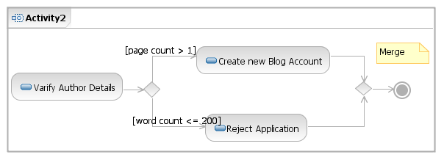
Activity Diagrams
Decision and Merges –
Decisions should be mutually exclusive
BAD! 2 guards may be true

Slide 19
Fork/Join (Concurrency , Synchronization)
Multitasking – Parallel actions. Use Forks and joins
Fork : one flow going into it and several leaving it. Denotes the beginning of parallel actions.
Join: All incoming flows must reach it before processing may continue .This denotes the end of parallel processing.
Fork and join in activity diagram represent by synchronization bars.

Slide 20
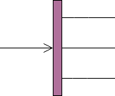
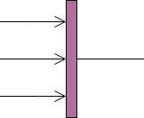
Fork
Join

Slide 21
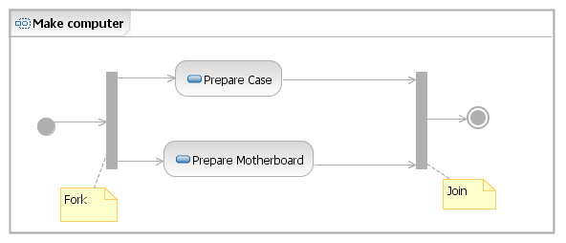

Slide 22
Verify Order Products Are In Stock
Receive Order
Verify Customer Has Available Credit
Accept Order

Slide 23
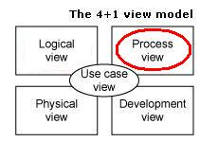
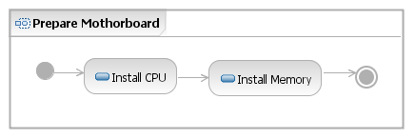
Activity Diagrams
Elaborate the activity

Slide 24
1.Object Flow
2. Input /output pins

Slide 25
Object Flow
object node is an activity node that indicates that an instance of a particular classifier, possibly in a particular state, might be available at a particular point in the activity (for example, as output from, or input to an action).
Object nodes act as containers to and from which objects of a particular type (and possibly in a particular state) might flow.
Central Buffer node

Slide 26
Example of Object Flow

Slide 27
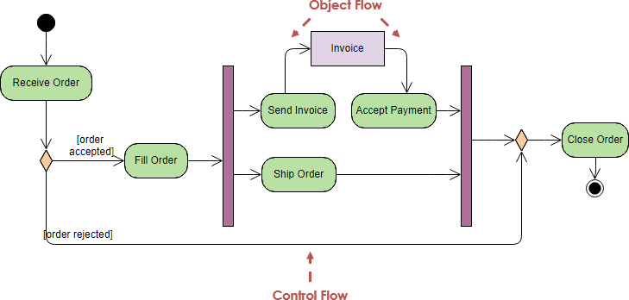

Slide 28
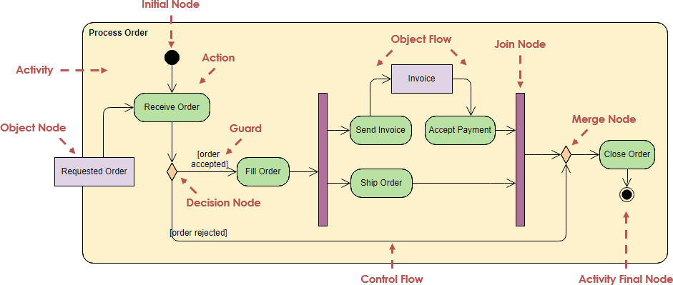

Slide 29
2. Input /output pins
A pin is an object node for inputs and outputs to action.
Pin is usually shown as a small rectangle attached to the action rectangle. The name of the pin can be displayed near the pin.
Pins to the actions – to avoid confusion due to multiple objects flowing

Slide 30
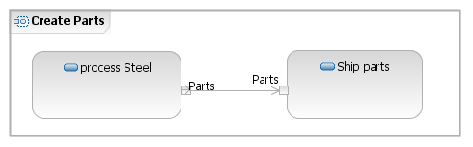

Slide 31


Examples:
Item is input pin to the Add to Shopping Cart action.
Invoice is output pin from the Create Invoice action.

Slide 32
Part
Part
Ship part
Process Steel
Input output pin
Process Steel
Ship part
Part
Object Flow

Slide 33
Report
Notify maintenance problem
Process Steel
Part
Ship part
Part
v
Input output and exception pin

Slide 34
Activity Partition
Swimlanes
Activity partition may be shown using a swimlane notation
Placing an activity within a swimlane indicates that it is performed by a person with the specific role or at the specific department in an organization

Slide 35
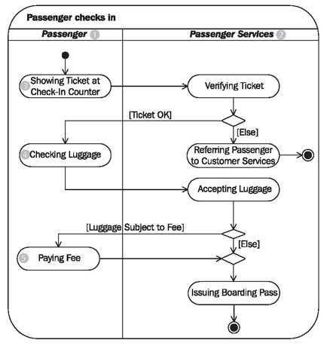

Slide 36
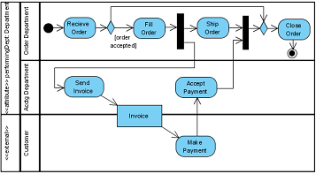

Slide 37
Appraisee
Appraiser
Reviewer
HR
Do self appraisal
Submit
Do assessment
Publish Tracker
[Capable]
[not capable]
Recommend
promotion
Review
Recommend
training plan
Update
personal
record
Submit
Activity Partitions - Swimlanes

Slide 38
Constraints on Action
-Use local pre and post condition
-Local condition : condition apply only at the point in the control flow where they are declared.
-precondition: define required state of system when the action is invoked
post condition: specifies required state of system at the completion of the action
Use note

Slide 39
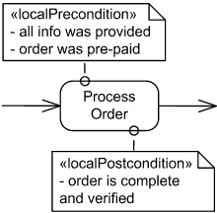

Slide 40
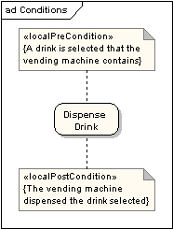

Slide 41
Signals
An Activity diagram can have a clearly defined start point, which corresponds to an invocation of a program or routine.
Activity diagram can also show response to signals.
A time signal occurs because of the passage of time (for example, each month end might trigger a signal.)
A real time signal indicates that the activity receives an event from an outside process.
The activity listens for those signals, and the diagram defines how the activity reacts.

Slide 42
Signals
Activity diagrams can show signals sent or received
For example, we can send a message and then wait for a reply before we can continue.
Basically, the signals are flow triggers.
Send signal Time signal Accept signal

Slide 43
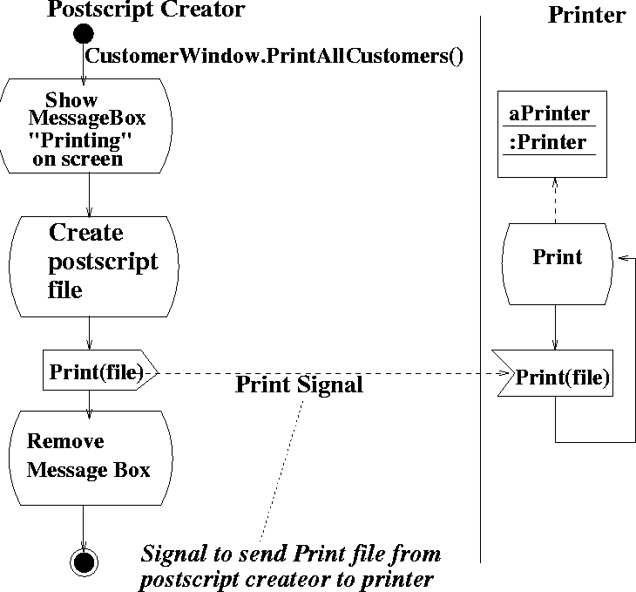

Slide 44
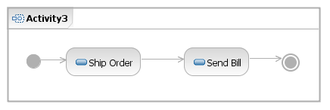
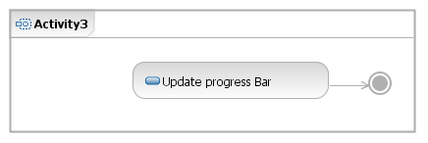
Activity Diagrams
Time events
One time event
Wait 3 days
Repeating event
1 Sec time out

Slide 45
Activity Diagrams
Other Action nodes
Action
Send signal
Accept event

Slide 46
Expansion Region
Structured activity region that executes multiple times corresponding to elements of an input collection.

Slide 47
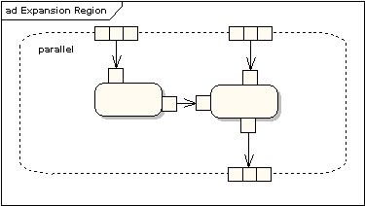

Slide 48
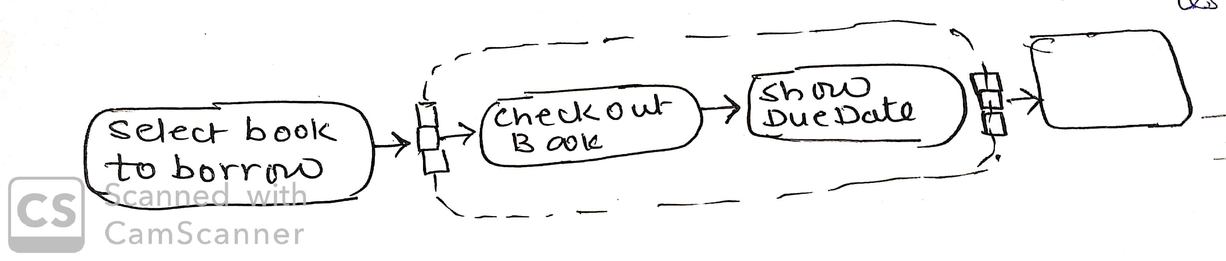

Slide 49
Exception handling
Activity diagram in Unified Modeling Language (UML) represents the flow from one activity to another within the system.
The exceptions in the activity diagrams are the events or actions that occur during the execution of a program that interrupts the normal execution.

Slide 50
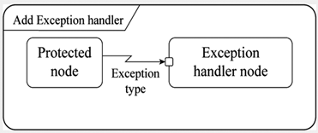
Exception handlers in activity diagrams can be modeled as shown in the figure below.
Exception handler in activity diagram:

Slide 51
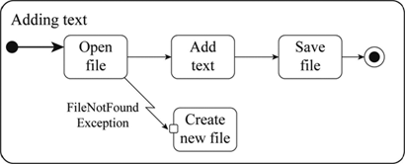

Slide 52
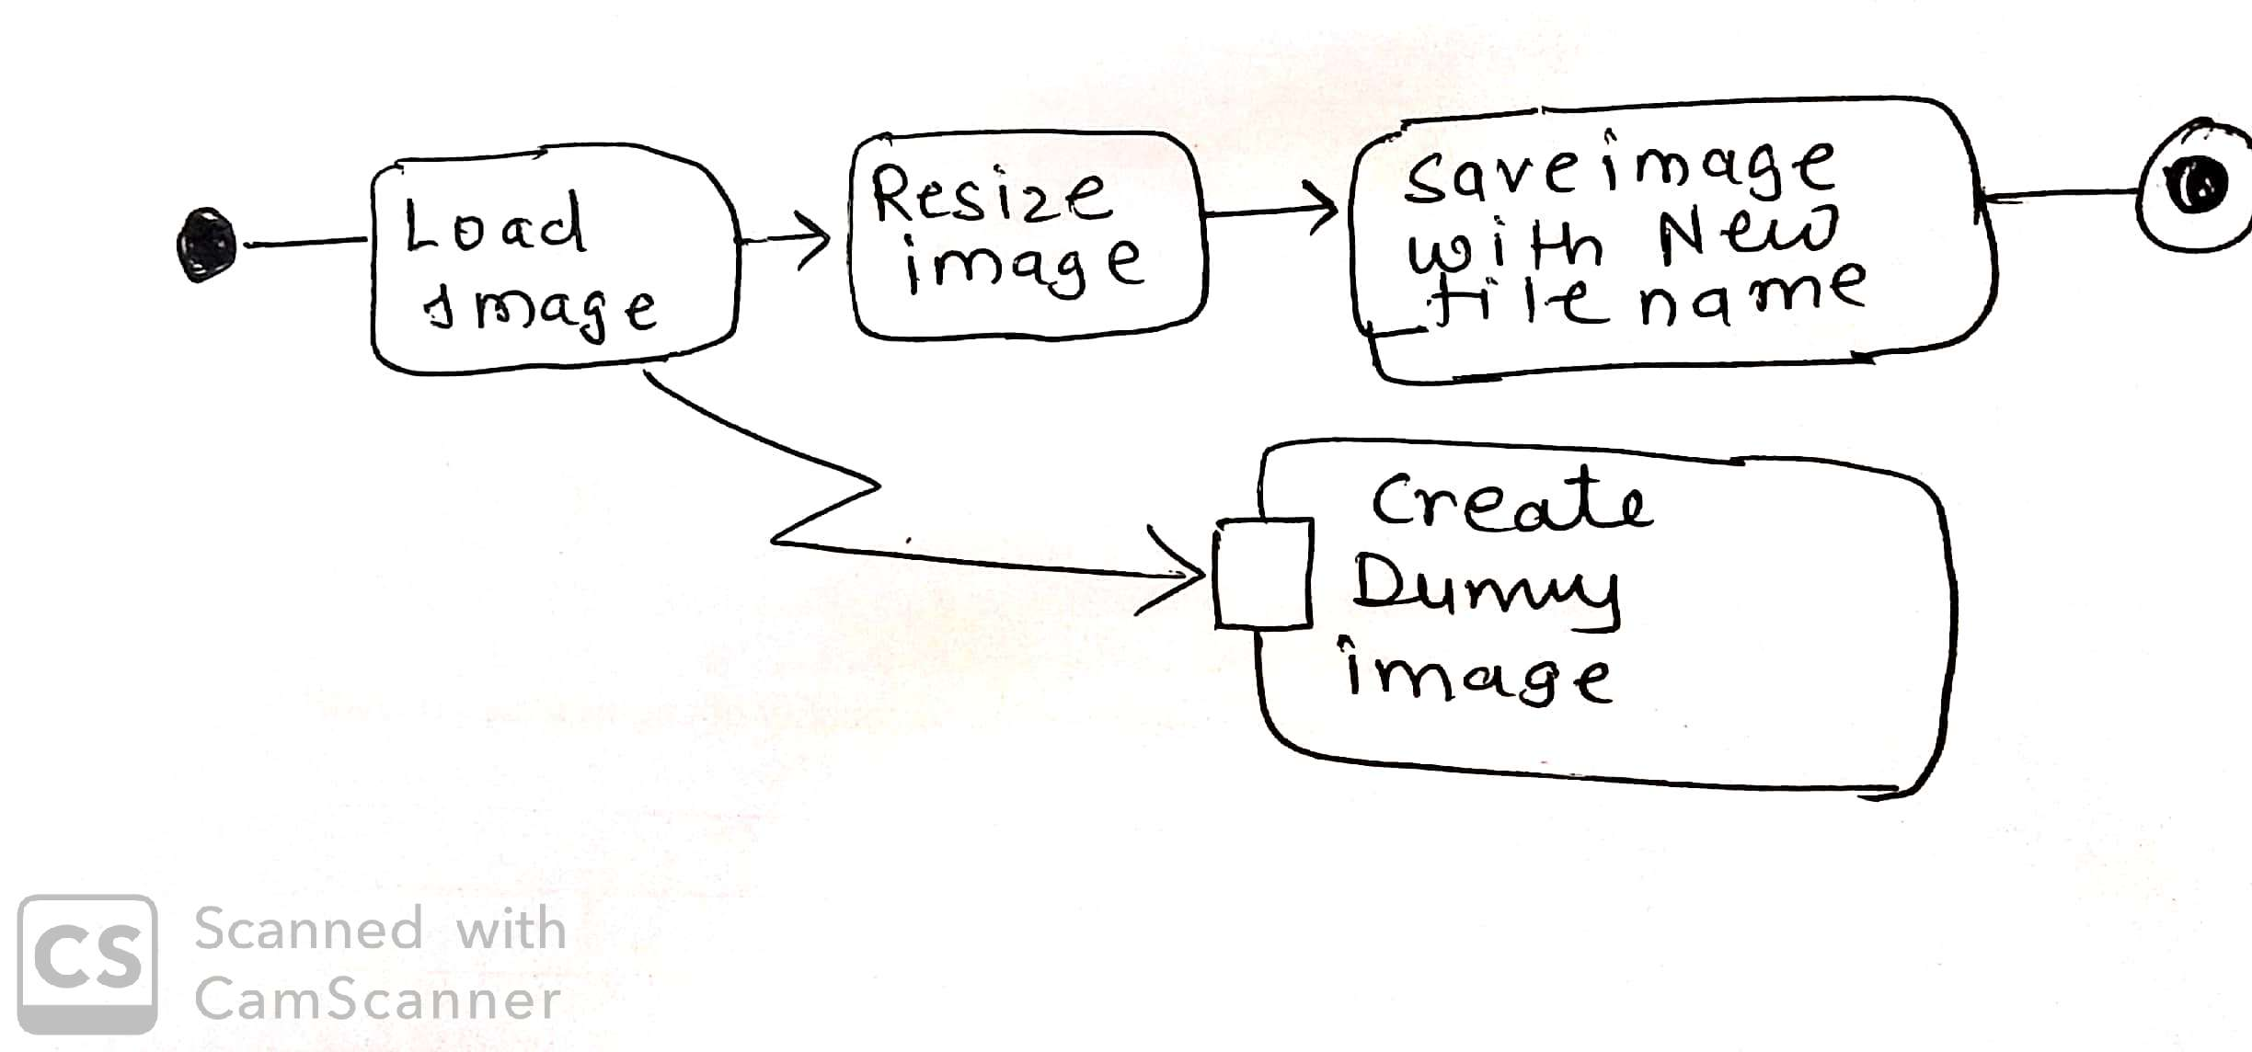

Slide 53
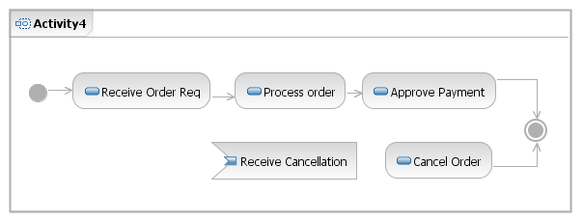
Activity Diagrams
Interrupting an Activity
Wait 3 days

Slide 54
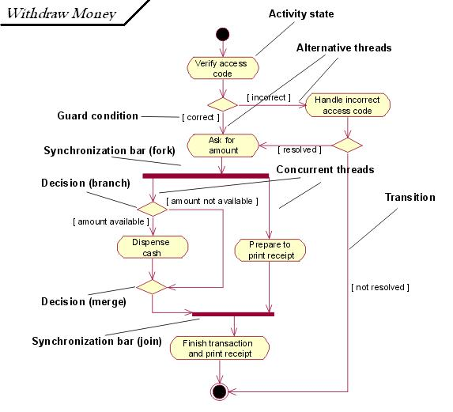
Activity Diagram

Slide 55
